Slide 1
CAE
Improvement of the arm in the suspension system of an electric vehicle.
21800330 박현의
21900416 안견힐
21900793 한태건

Slide 2
CONTENTS
Introduction (issue)
Conditions (Boundary, Contact, Force)
Mesh
Static Analysis
Result & Discussion

Slide 3
PART 1.
Introduction (Issue)

Slide 4
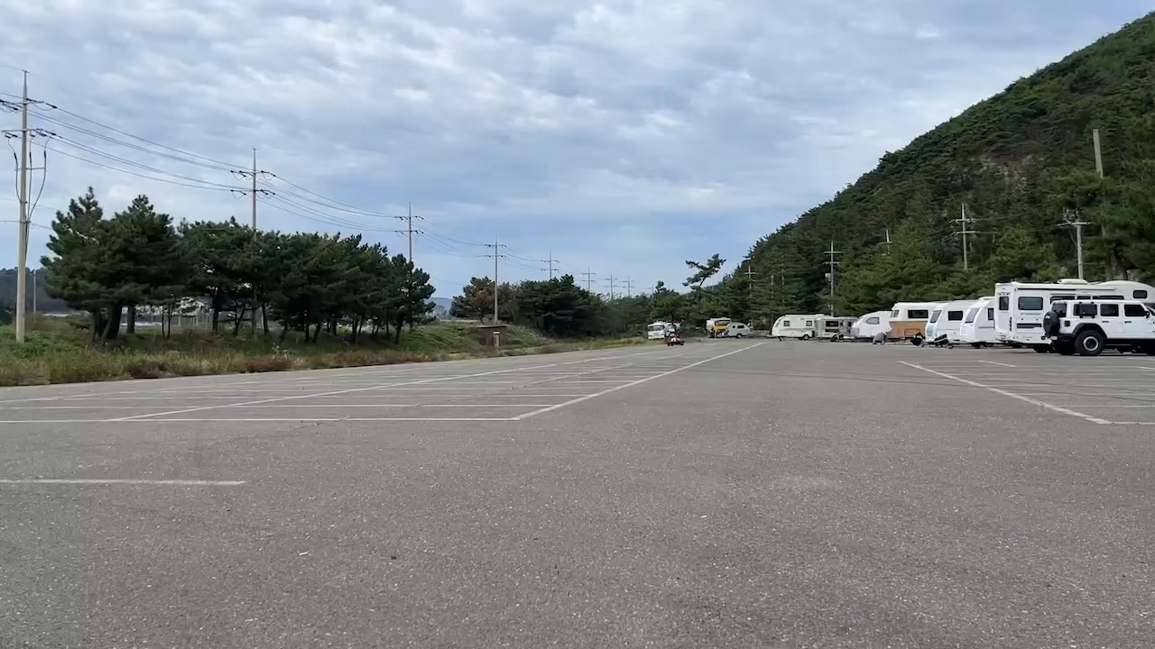
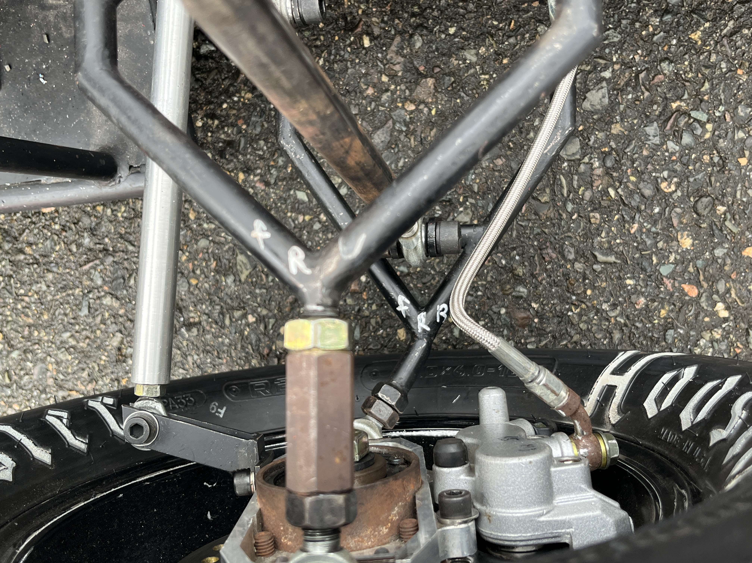
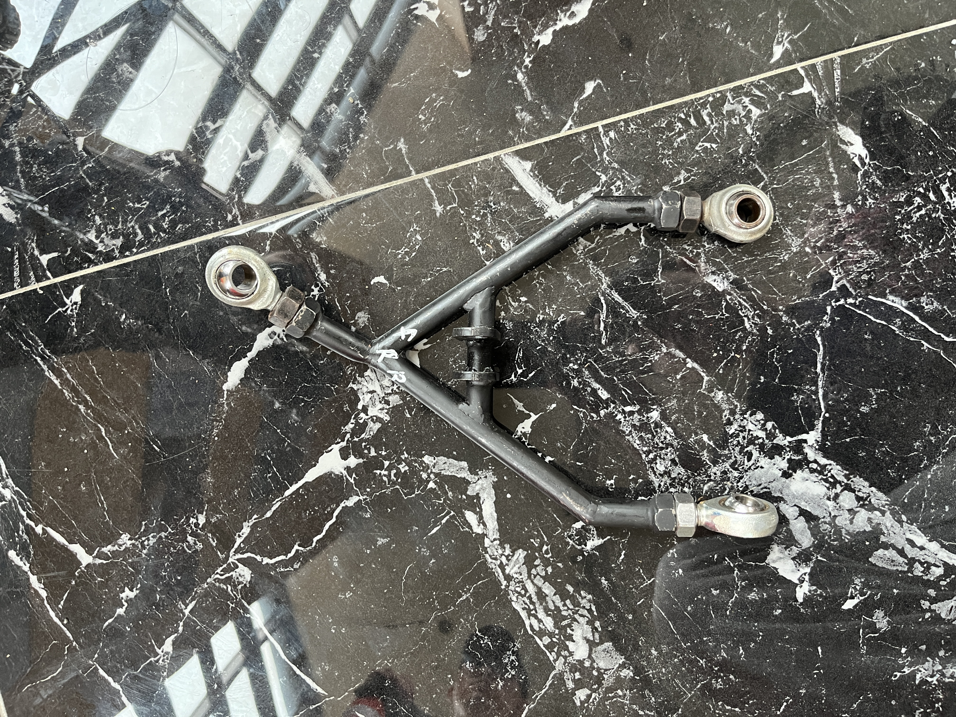
1. Issue
PART 2.
PART 3.
PART 4.
PART 5.
A strong force is applied to the arm during a sudden connering of the vehicle, causing bending force to act
(차량 코너링시 암에 강한 굽힘힘이 작용하여 휘는 현상이 발생함)

Slide 5
PART 2. Conditions

Slide 6
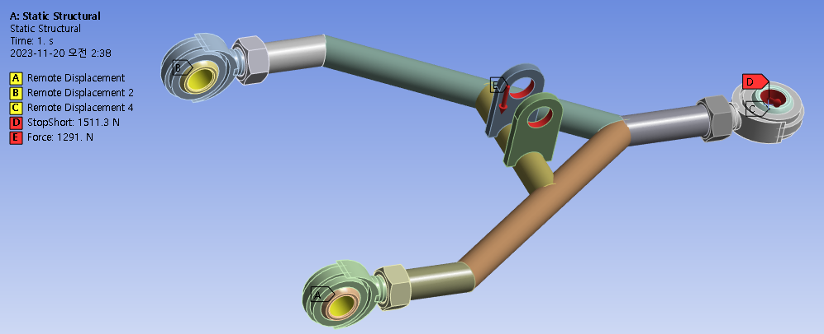
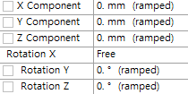
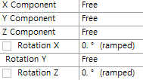
1. Boundary Condition
PART 1.
2. Conditions
PART 3.
PART 4.
PART 5.

Slide 7
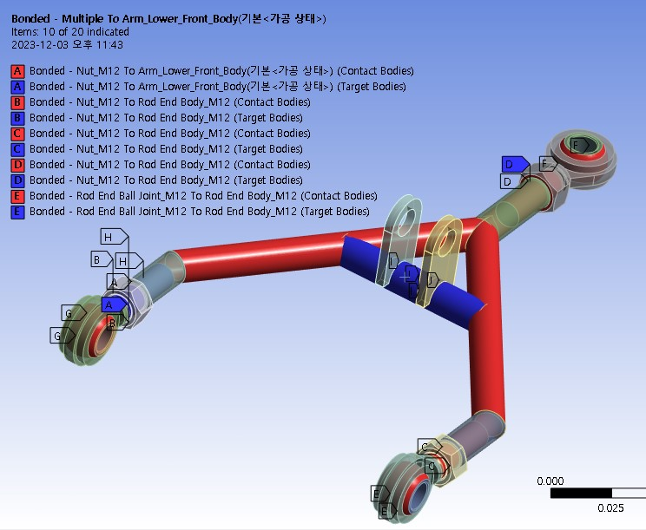
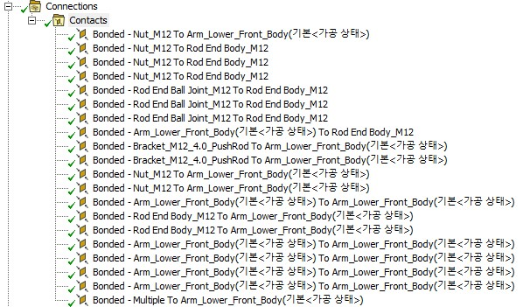
2. Contact Condtion
PART 1.
2. Conditions
PART 3.
PART 4.
PART 5.

Slide 8
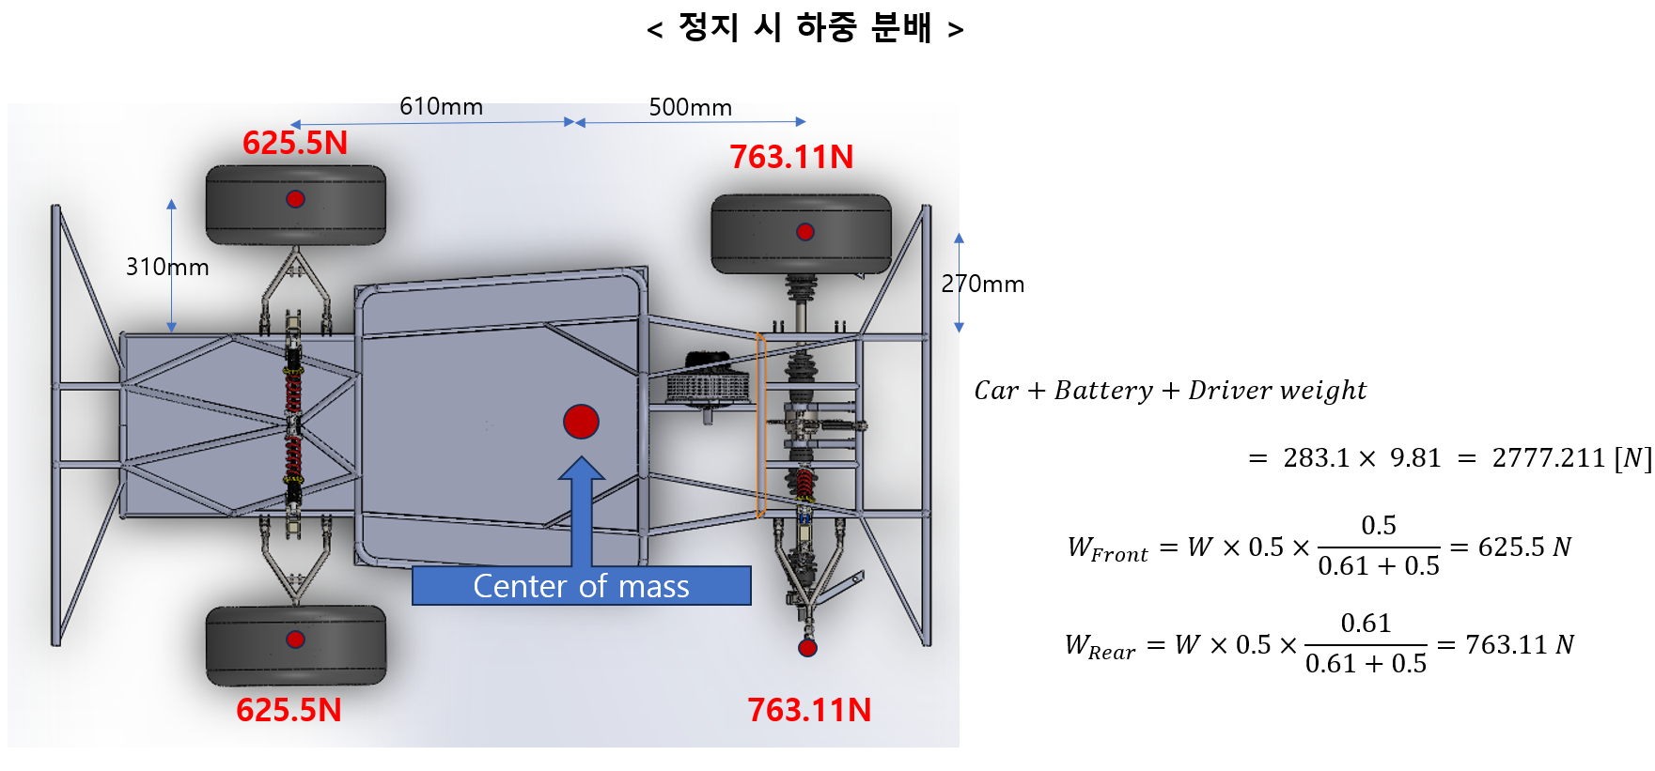
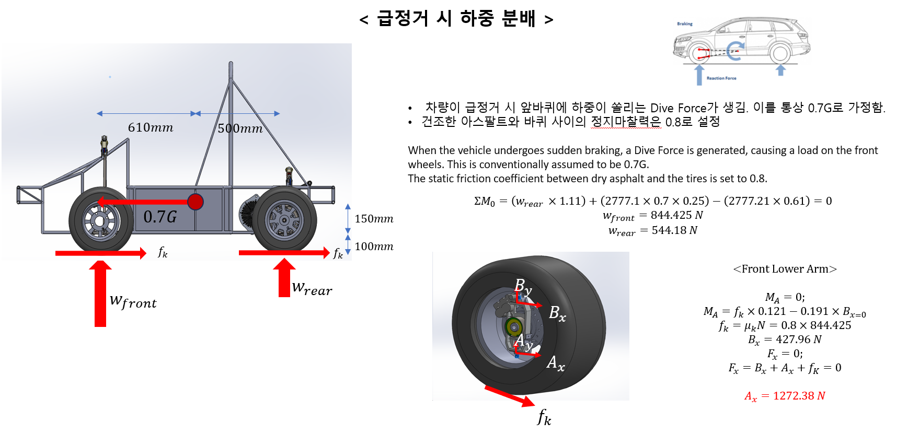
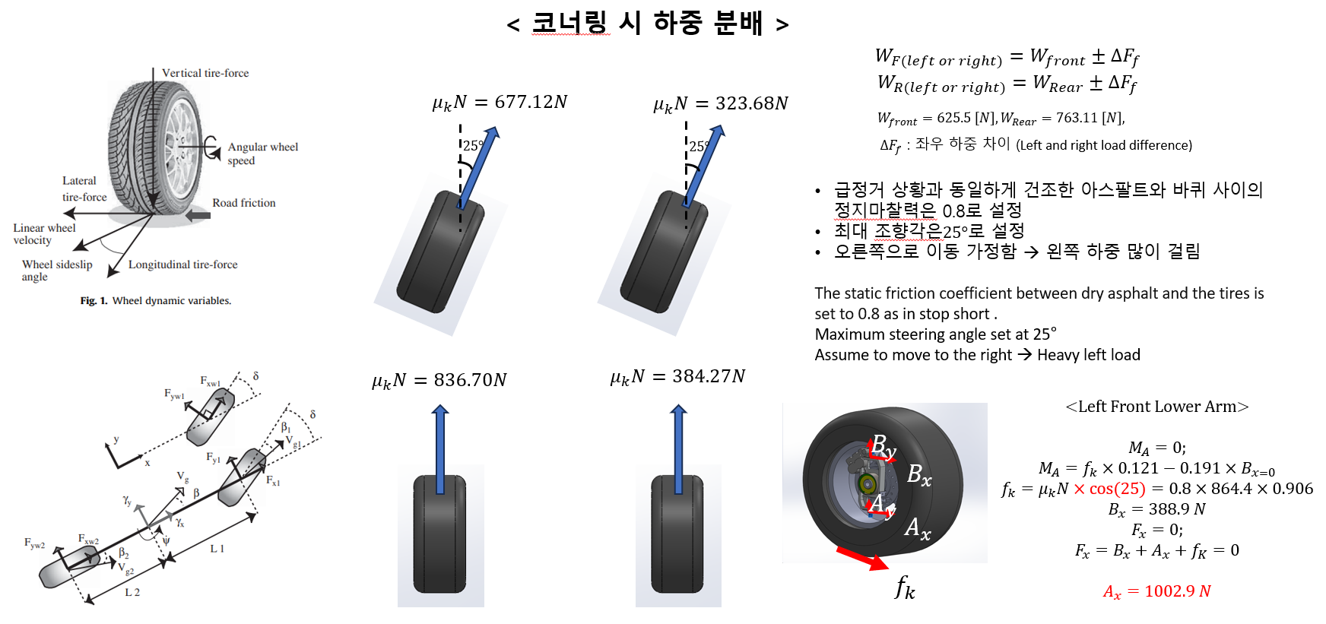
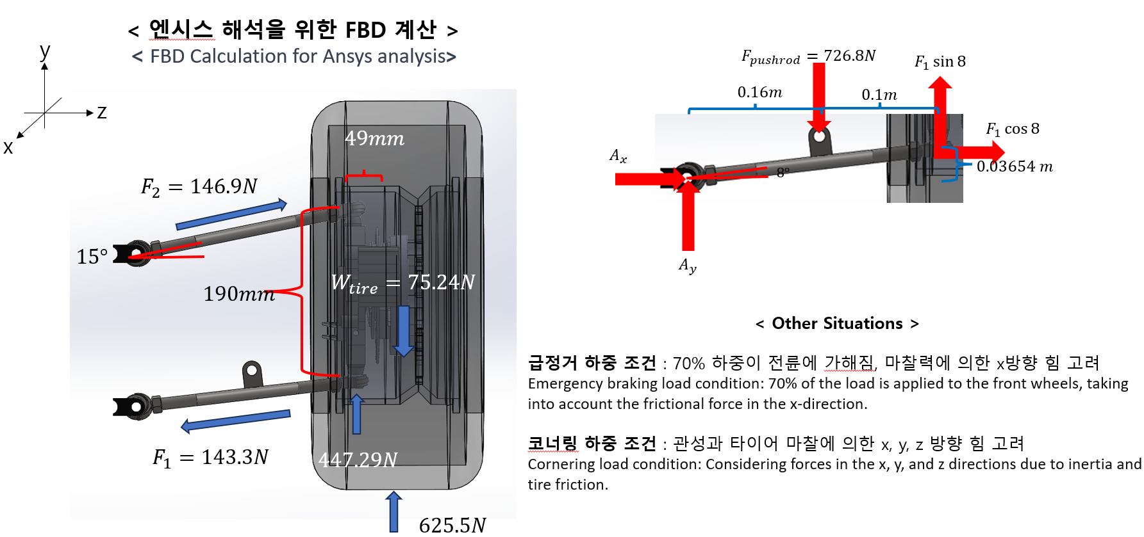
3. Force Condition
PART 1.
2. Conditions
PART 3.
PART 4.
PART 5.

Slide 9
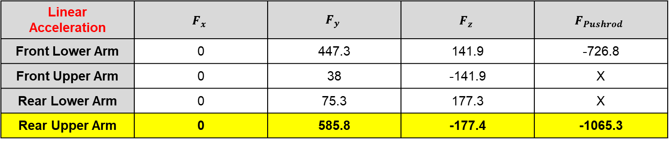
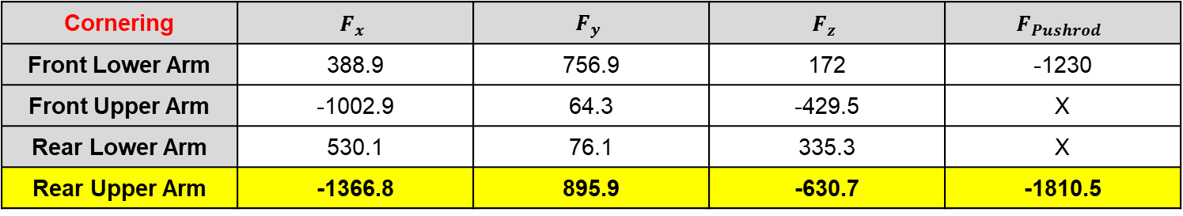
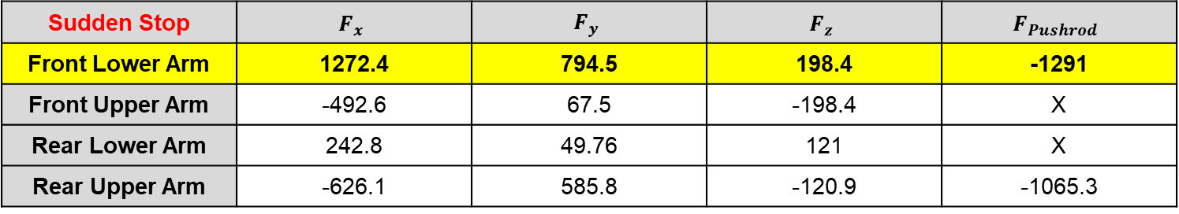
3. Force Condition
PART 1.
2. Conditions
PART 3.
PART 4.
PART 5.
Linear Acceleration | $$F_{x}$$ | $$F_{y}$$ | $$F_{z}$$ | $$F_{Pushrod}$$
Front Lower Arm | 0 | 447.3 | 141.9 | -726.8
Front Upper Arm | 0 | 38 | -141.9 | X
Rear Lower Arm | 0 | 75.3 | 177.3 | X
Rear Upper Arm | 0 | 585.8 | -177.4 | -1065.3
Sudden Stop | $$F_{x}$$ | $$F_{y}$$ | $$F_{z}$$ | $$F_{Pushrod}$$
Front Lower Arm | 1272.4 | 794.5 | 198.4 | -1291
Front Upper Arm | -492.6 | 67.5 | -198.4 | X
Rear Lower Arm | 242.8 | 49.76 | 121 | X
Rear Upper Arm | -626.1 | 585.8 | -120.9 | -1065.3
Cornering | $$F_{x}$$ | $$F_{y}$$ | $$F_{z}$$ | $$F_{Pushrod}$$
Front Lower Arm | 388.9 | 756.9 | 172 | -1230
Front Upper Arm | -1002.9 | 64.3 | -429.5 | X
Rear Lower Arm | 530.1 | 76.1 | 335.3 | X
Rear Upper Arm | -1366.8 | 895.9 | -630.7 | -1810.5

Slide 10
PART 3.
Mesh

Slide 11
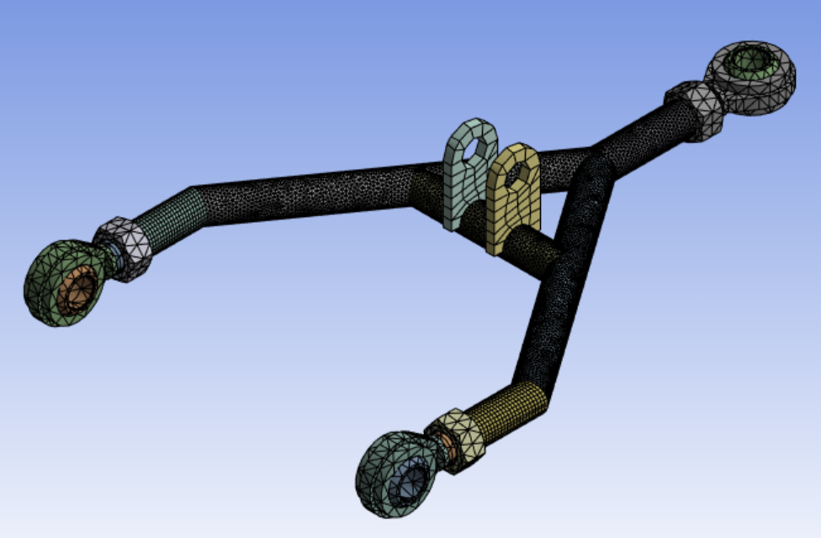
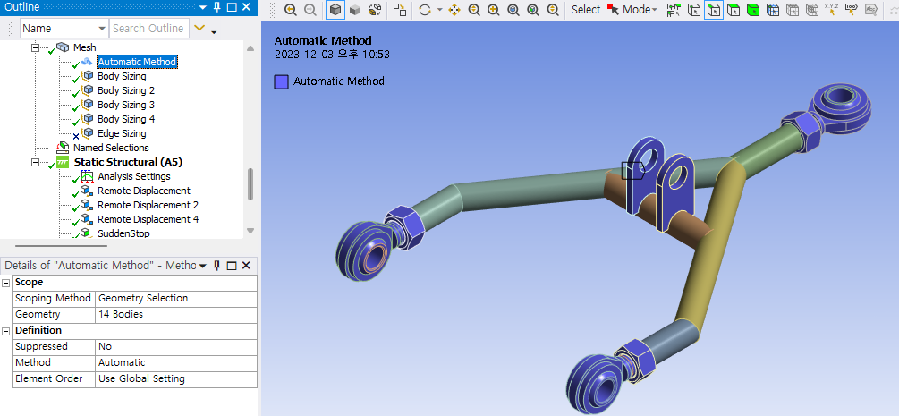
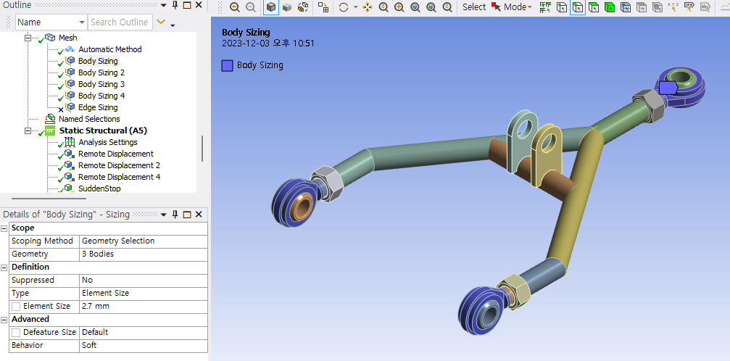
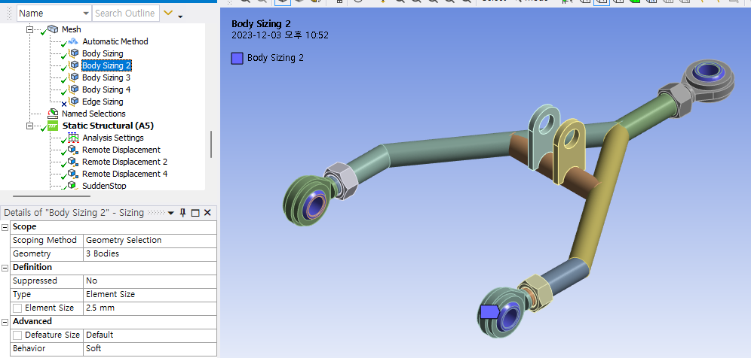
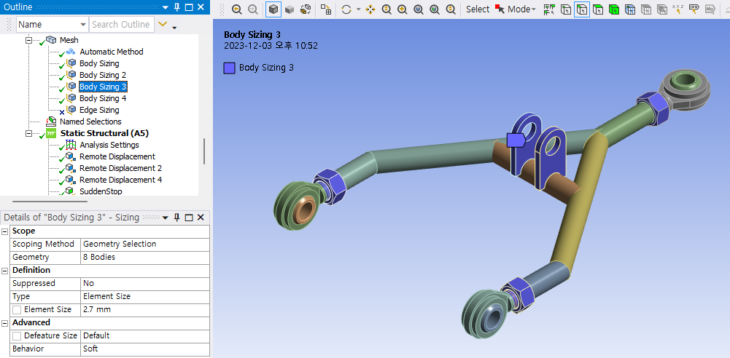
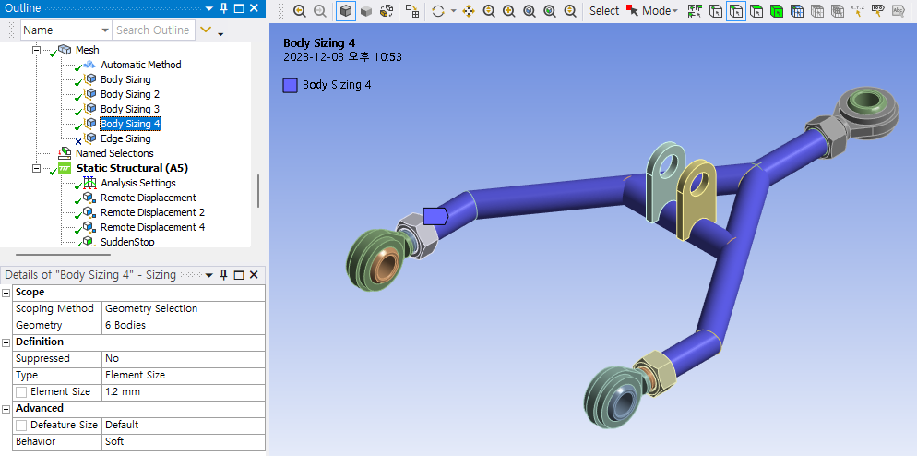
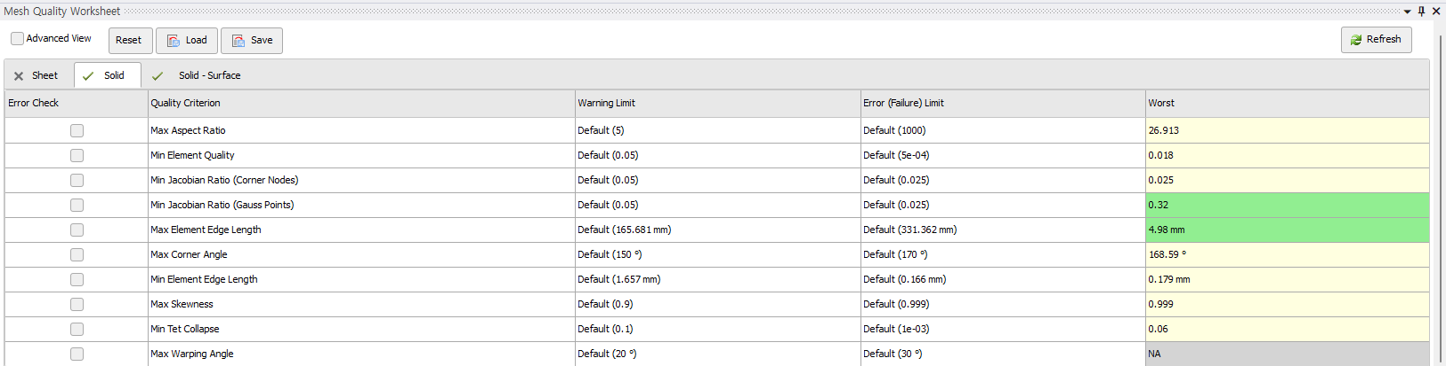
1. Mesh Quality & Method (Front Lower – old)
PART 1.
PART 2.
3. Mesh
PART 4.
PART 5.
(1) Automatic : except pipe
(2) 2.7mm : ball bearing, nut & bracket
(3) 2.5mm : ball joint
(4) 1.2mm : pipe

Slide 12
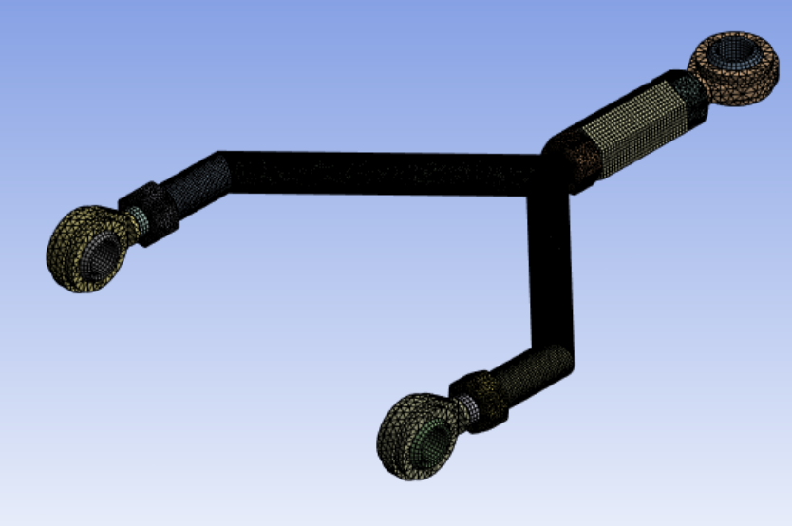
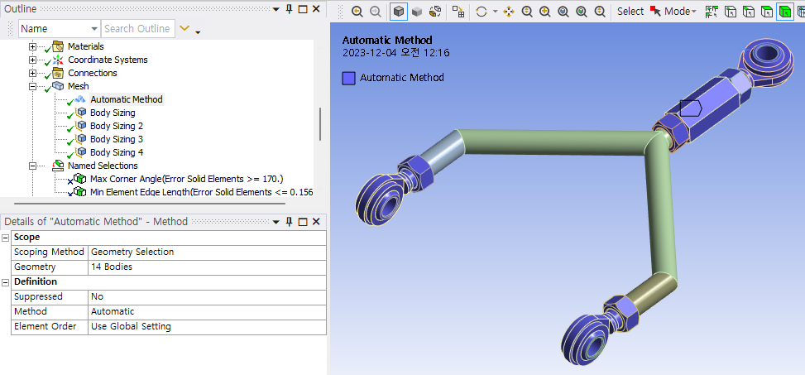
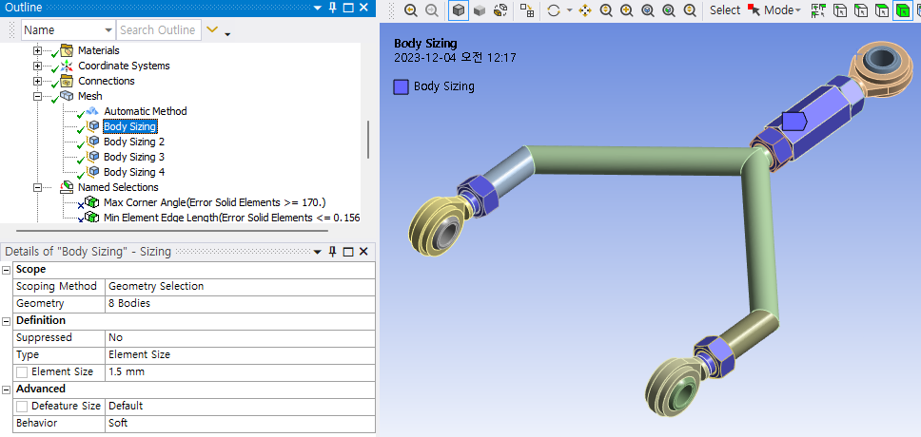
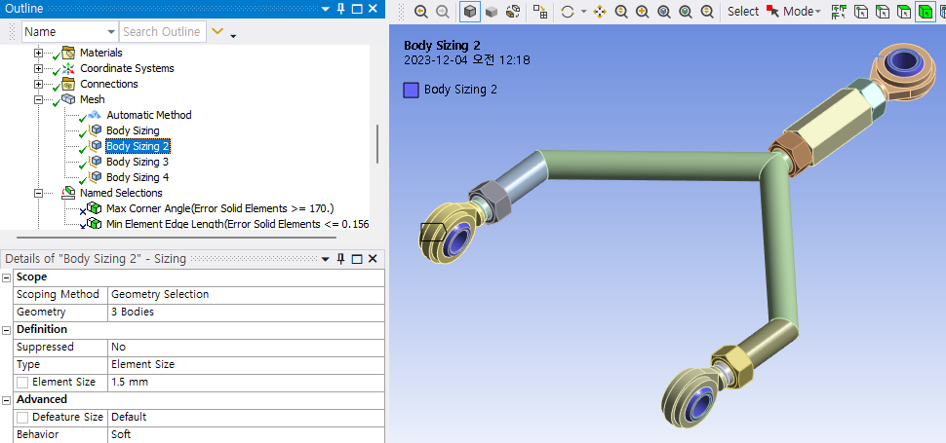
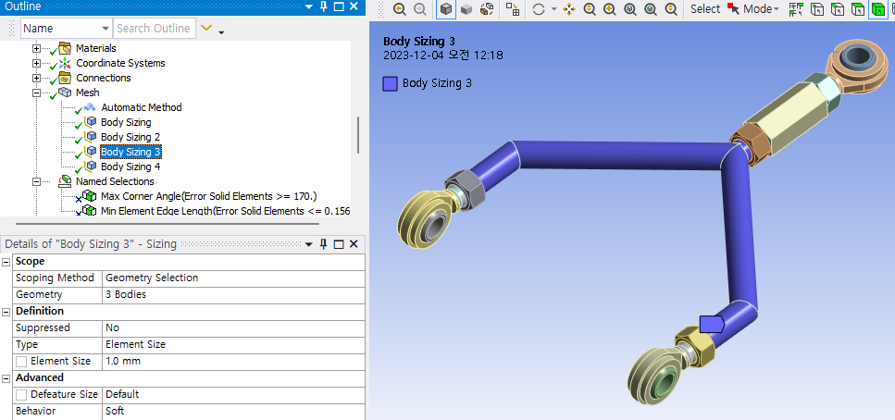
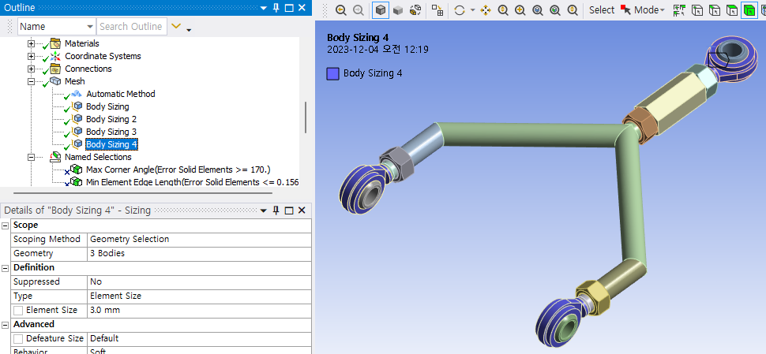
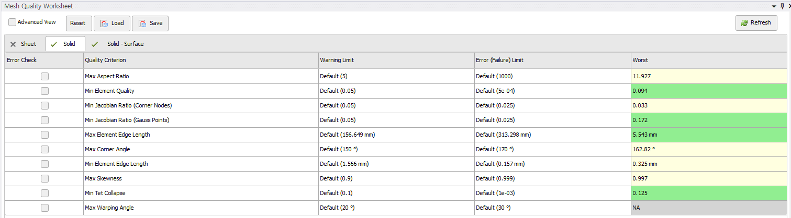
2. Mesh Quality & Method (Front Upper – old)
PART 1.
PART 2.
3. Mesh
PART 4.
PART 5.
(1) Automatic : except pipe
(2) 1.5mm : nut & tune buckle, ball joint
(4) 1.0mm: pipe
(5) 3.0mm: ball bearing

Slide 13
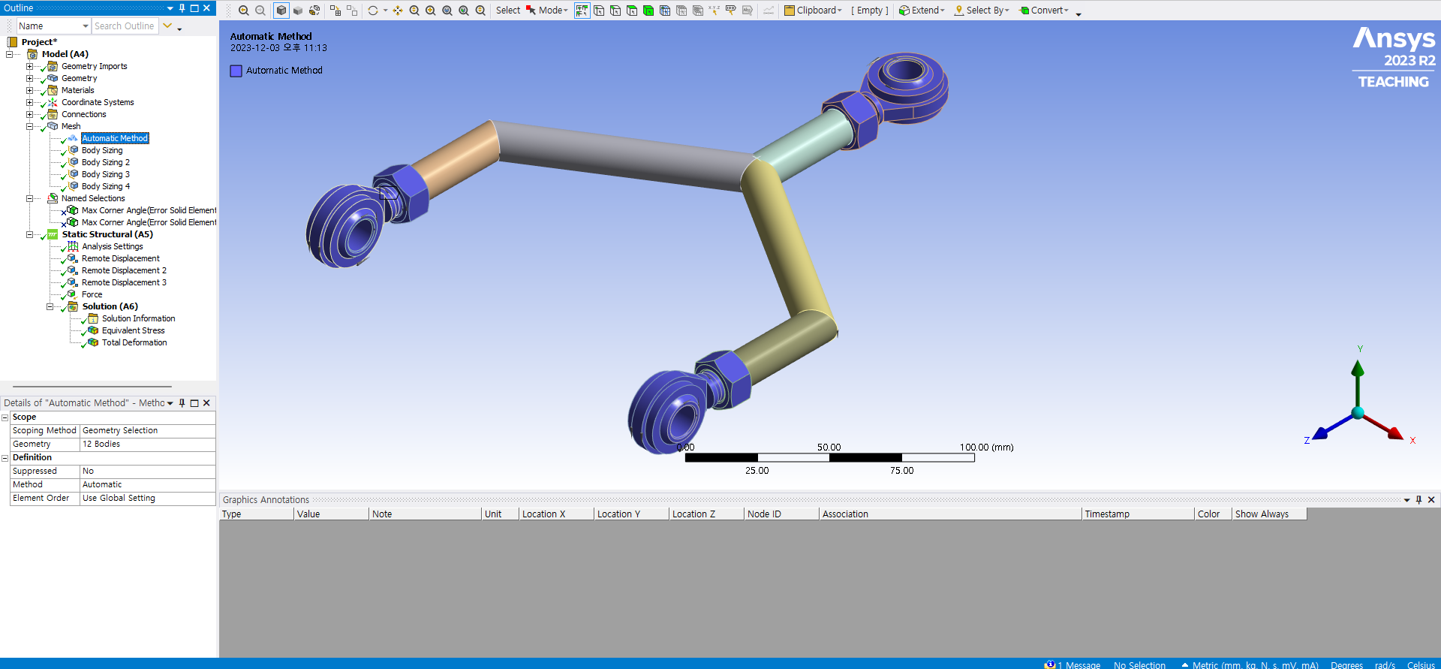
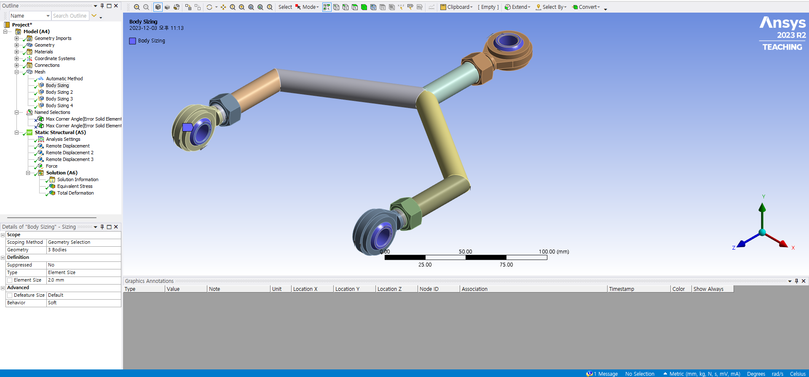
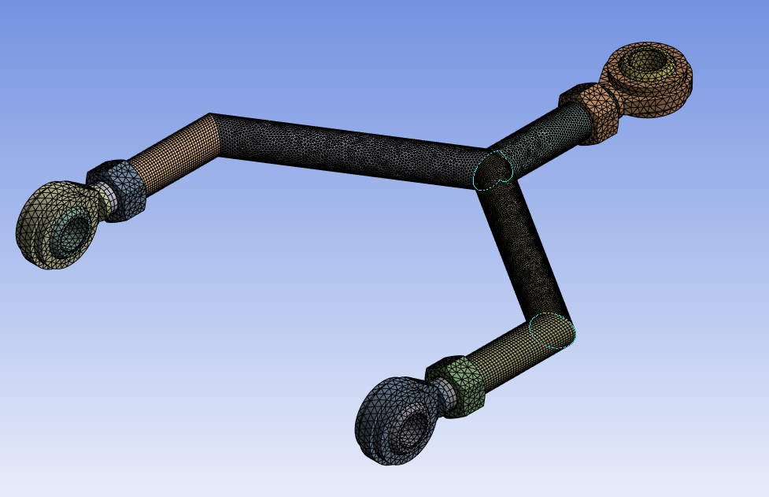
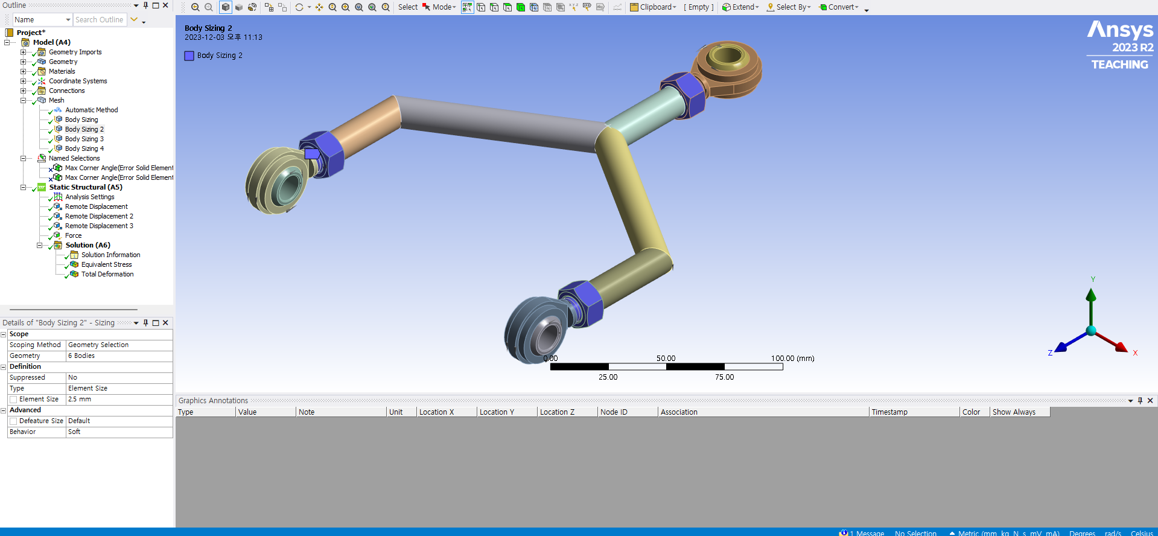
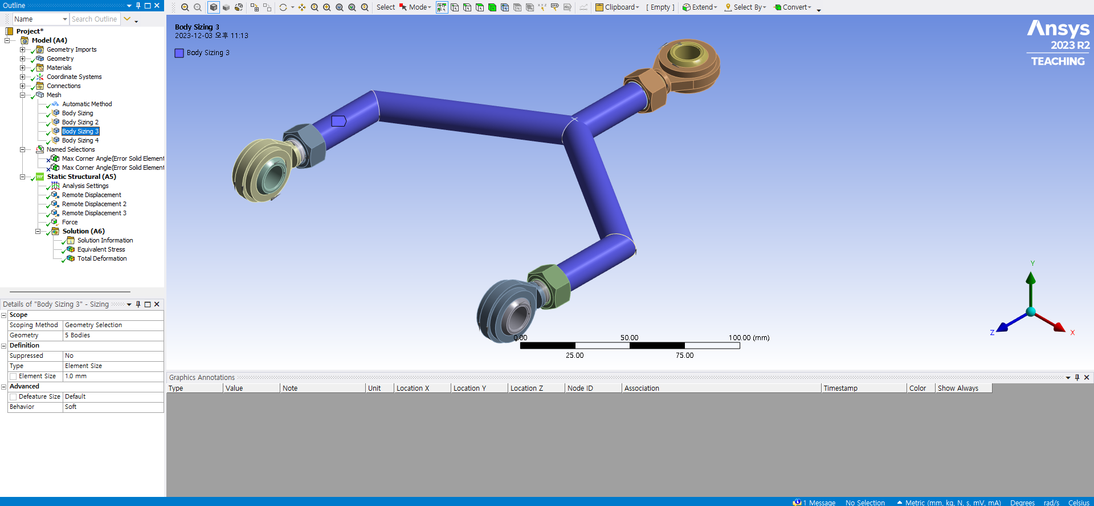
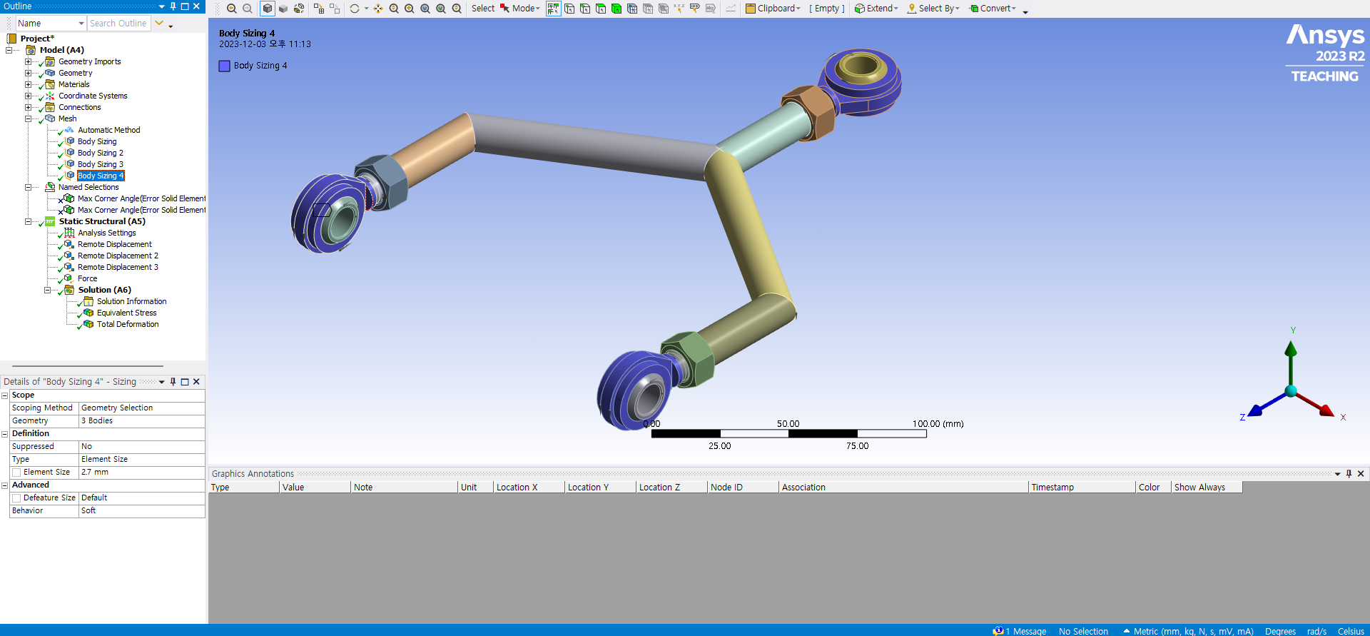
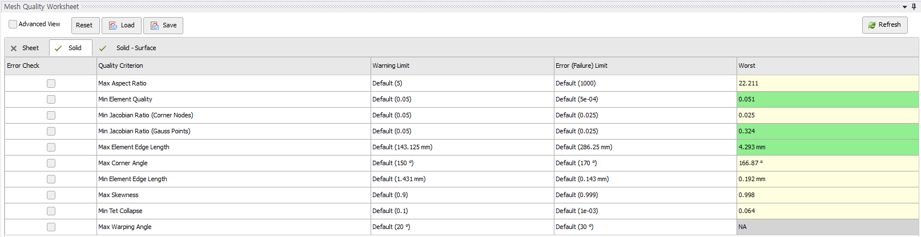
3. Mesh Quality & Method (Rear Lower – old)
PART 1.
PART 2.
3. Mesh
PART 4.
PART 5.
(1) Automatic : except pipe
(2) 1mm : pipe
(3) 2mm : ball bearing
(4) 2.5mm : nut
(5) 2.7mm : rod end body

Slide 14
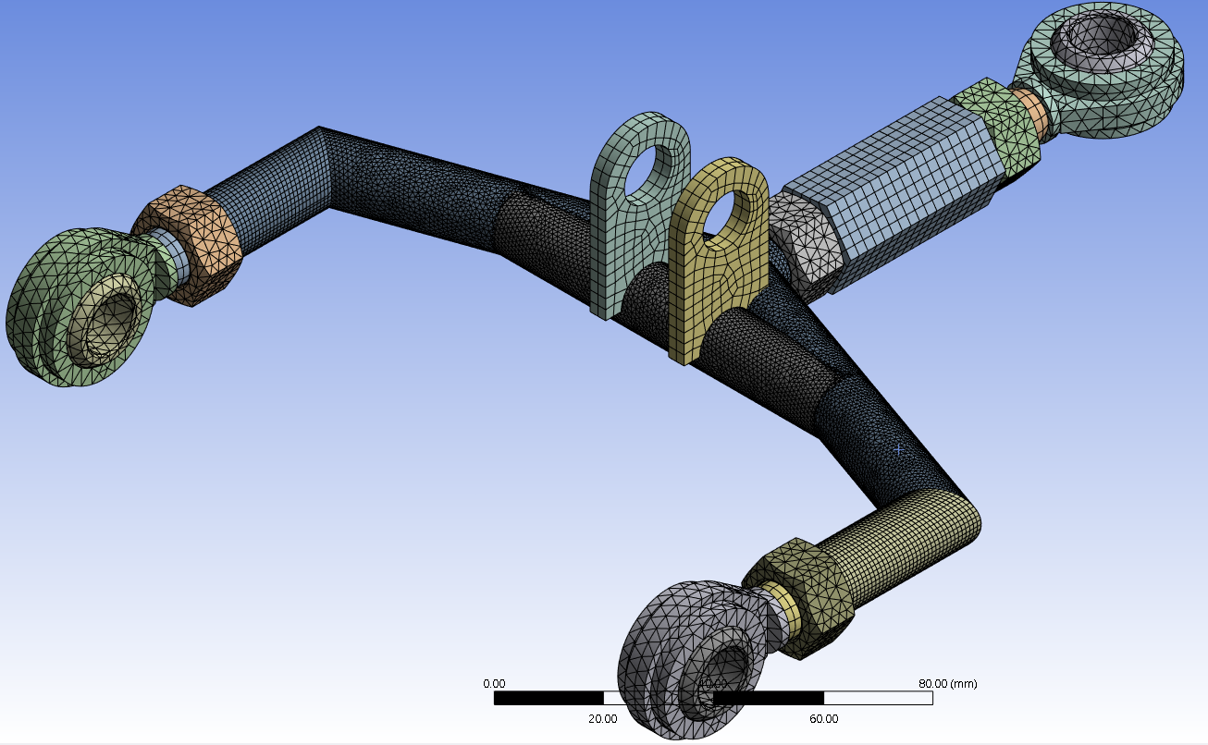
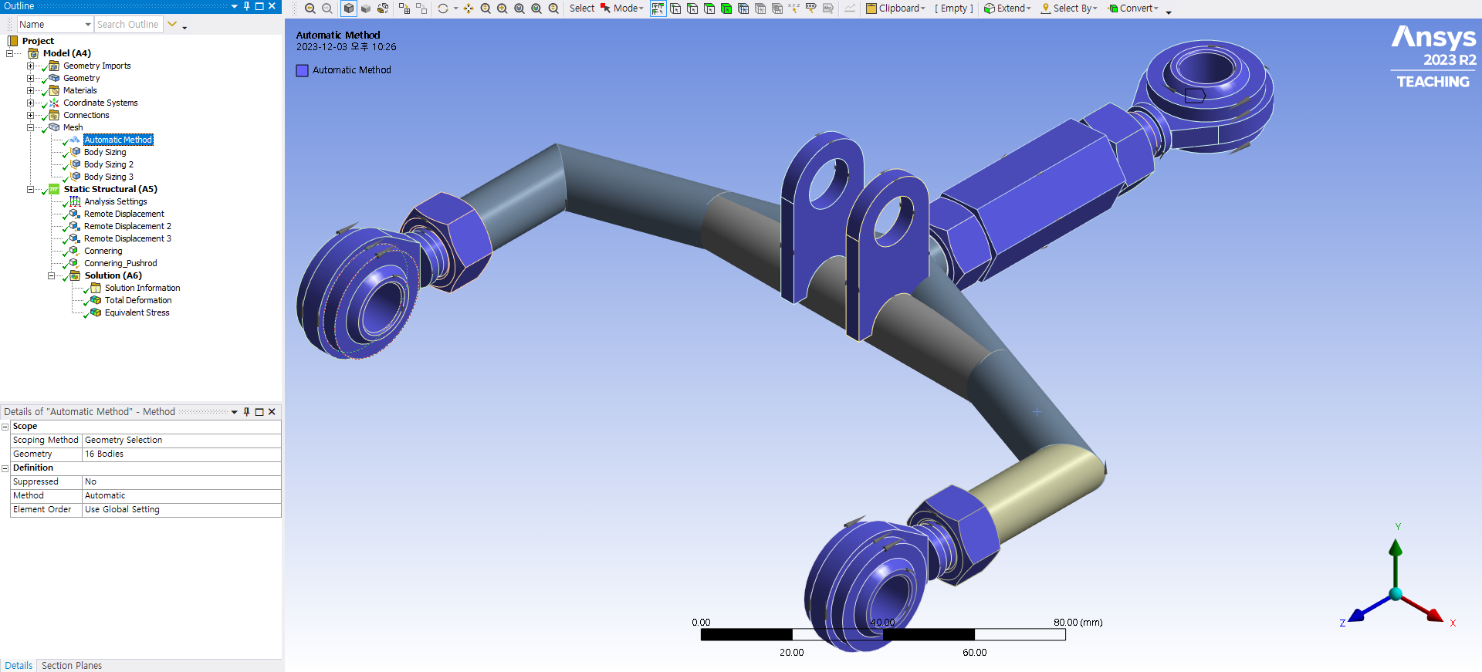
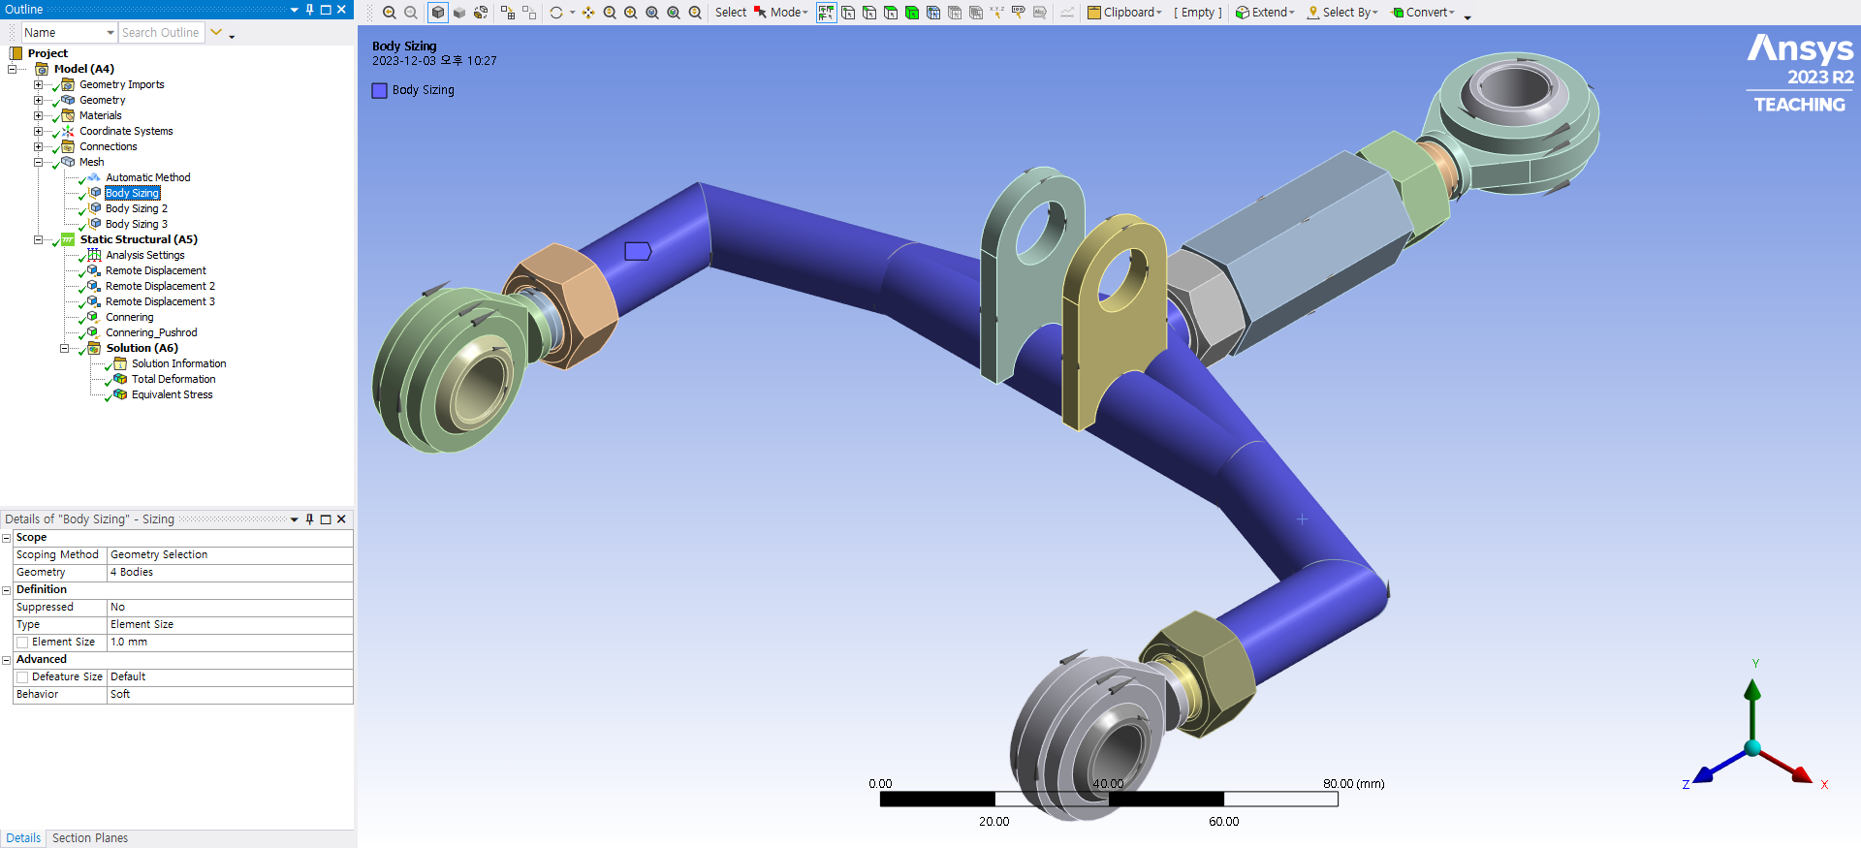
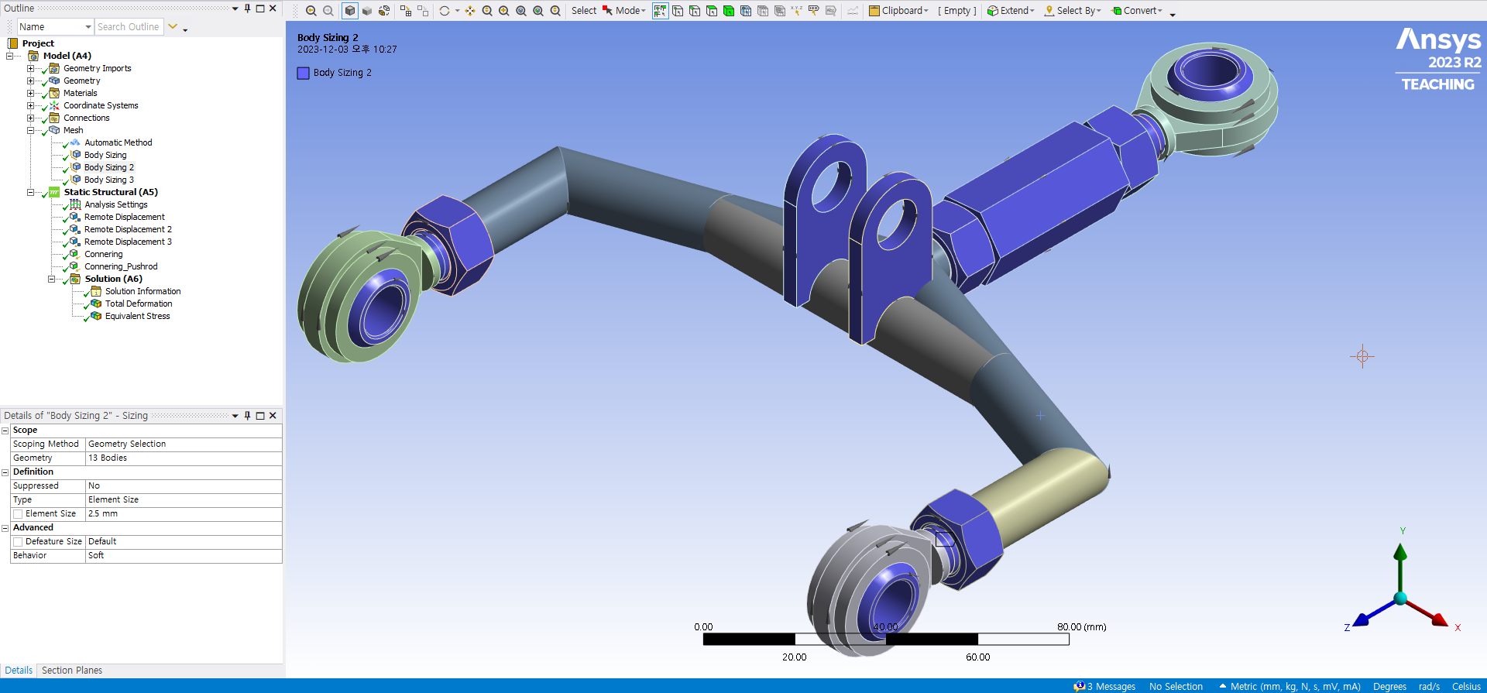
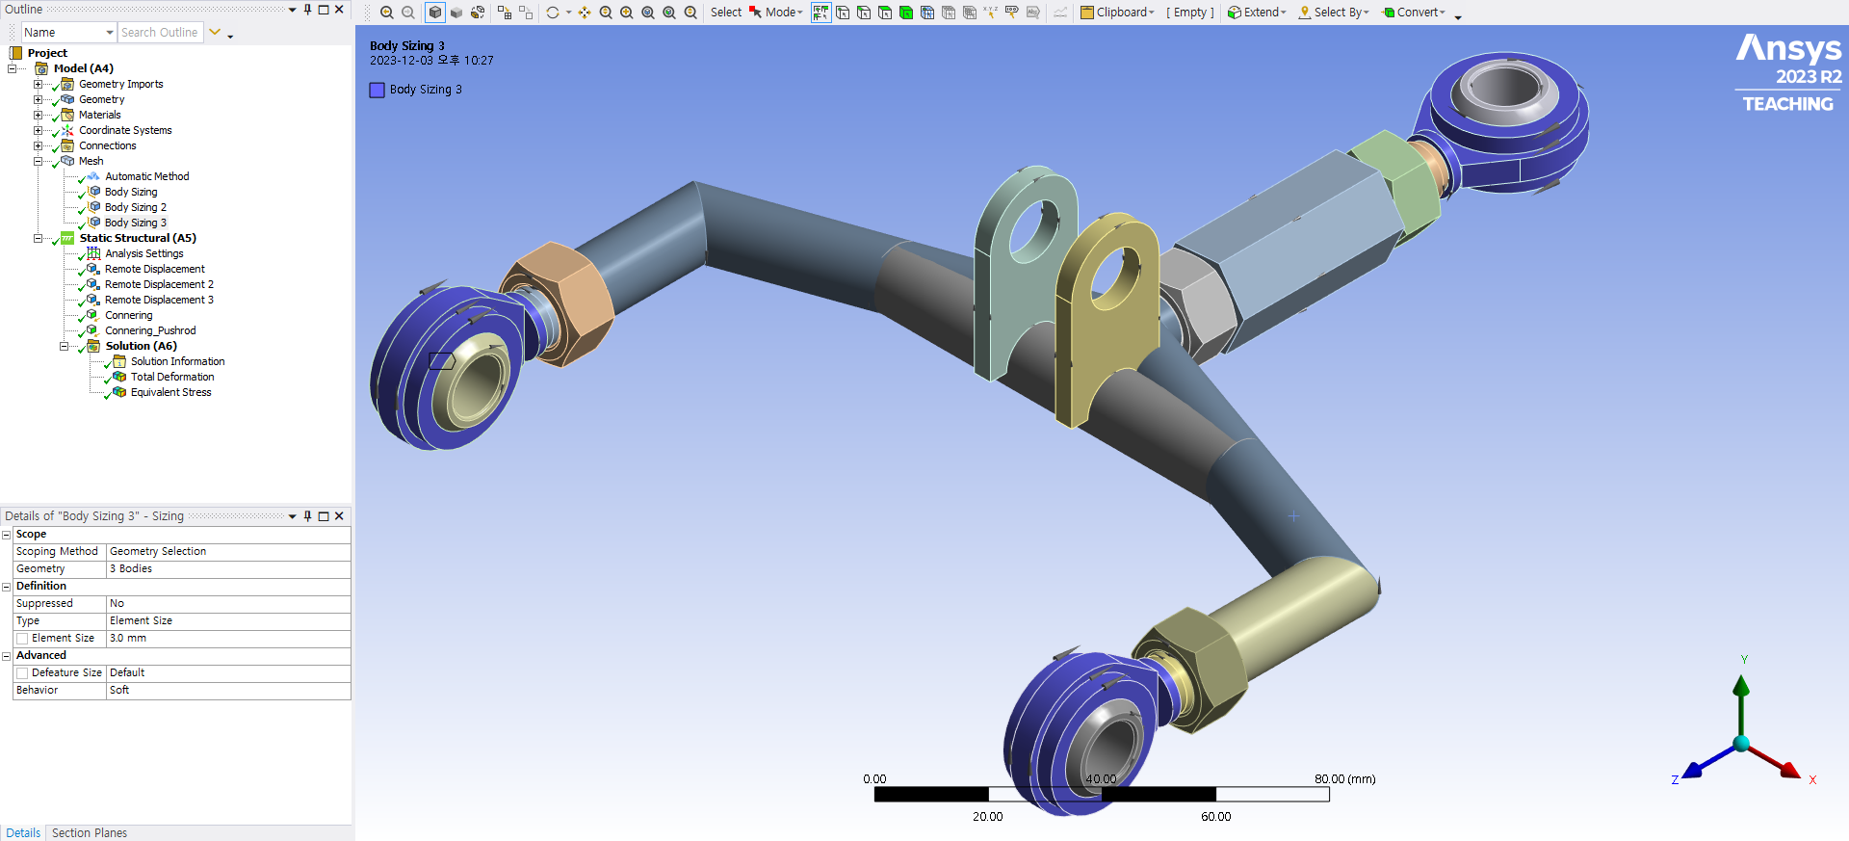
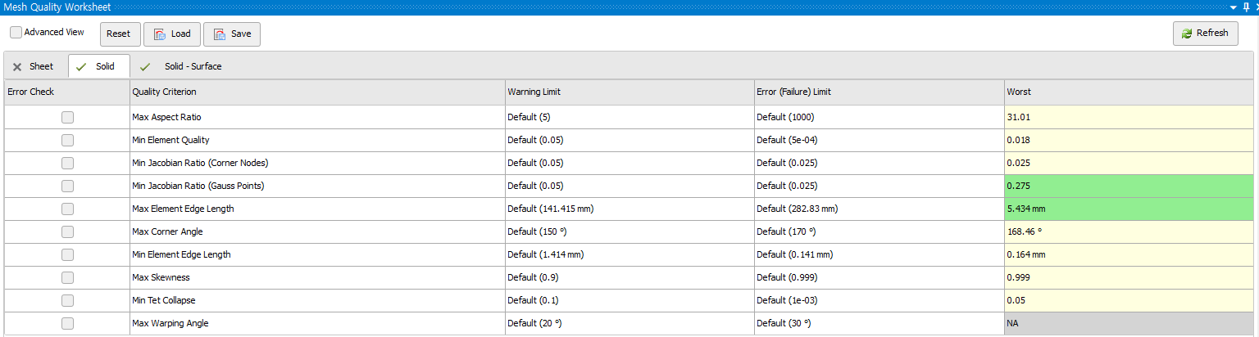
PART 1.
PART 2.
3. Mesh
PART 4.
PART 5.
4. Mesh Quality & Method (Rear Upper – old)
(1) Automatic : Except pipe
(2) 1mm : pipe
(3) 2.5mm : ball bearing and nut
(4) 3mm : rod end body

Slide 15
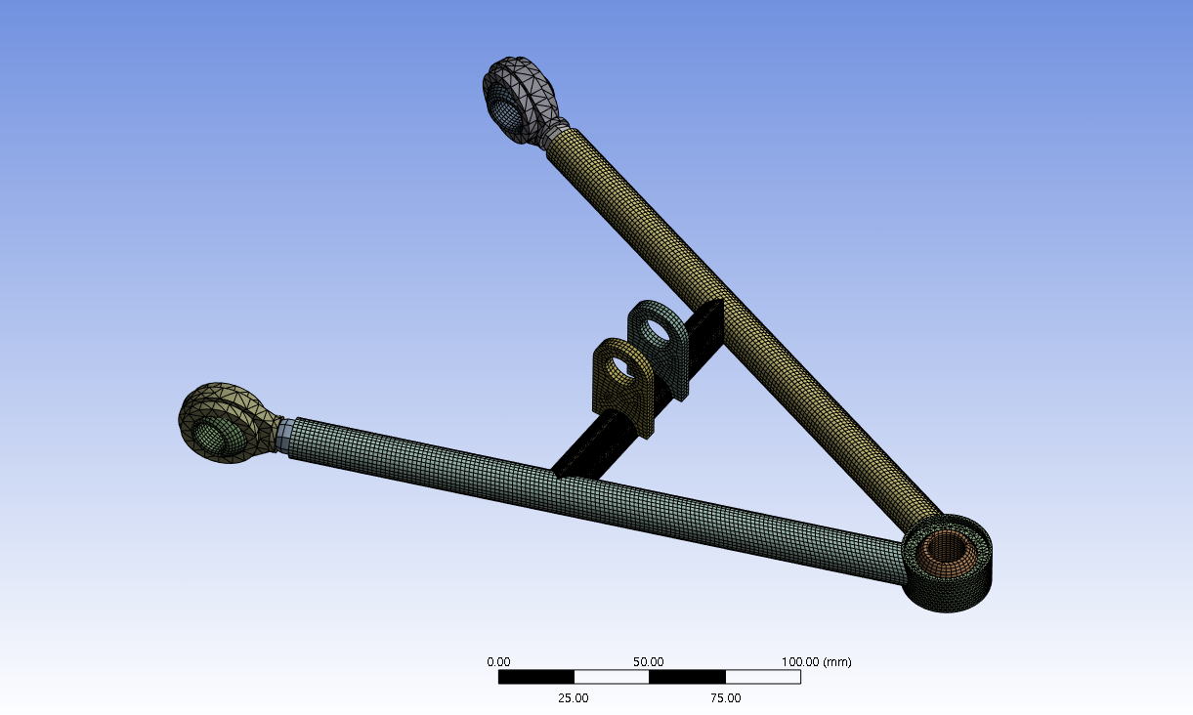
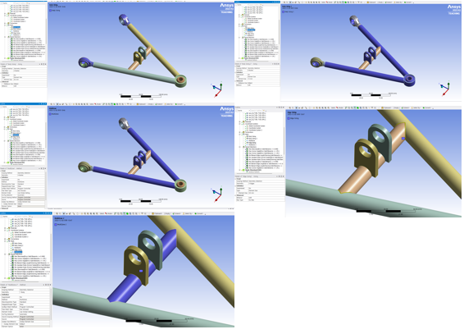
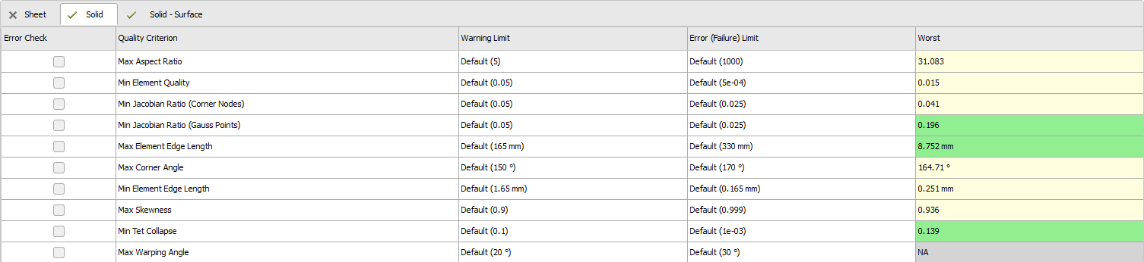
5. Mesh Quality & Method (Upper – New)
PART 1.
PART 2.
3. Mesh
PART 4.
PART 5.
(1) Multi Zone : pipe
(2) 1.5mm : bracket and ball bearing
(3) Edge : contact region of pipe
(4) 5mm : rod end body

Slide 16
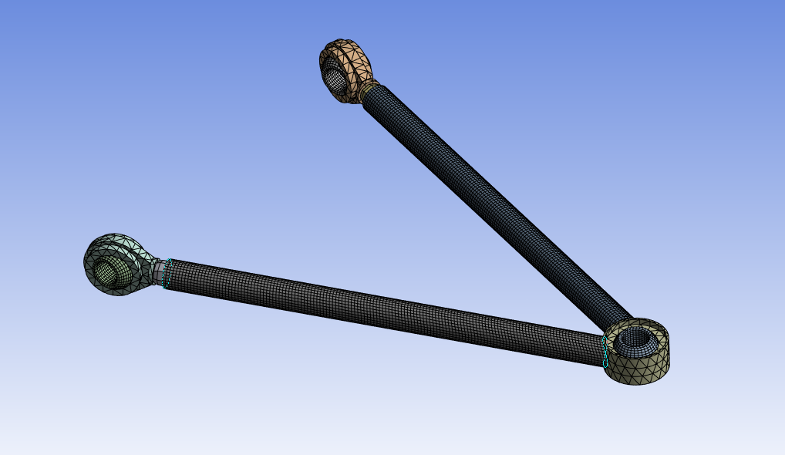
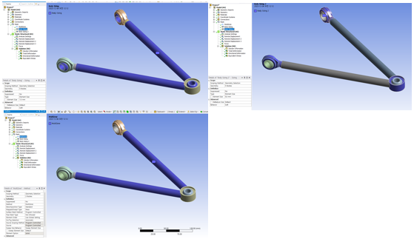
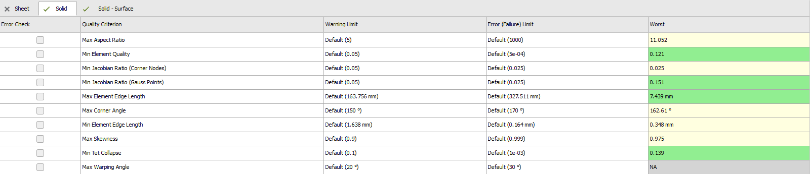
6. Mesh Quality & Method (Lower – New)
PART 1.
PART 2.
3. Mesh
PART 4.
PART 5.
(1) Multi Zone : pipe
(2) 1.5mm : pipe and ball bearing
(3) 5mm : rod end body

Slide 17
PART 4.
Static Analysis

Slide 18
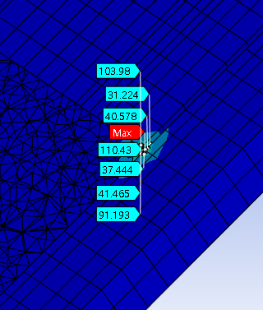
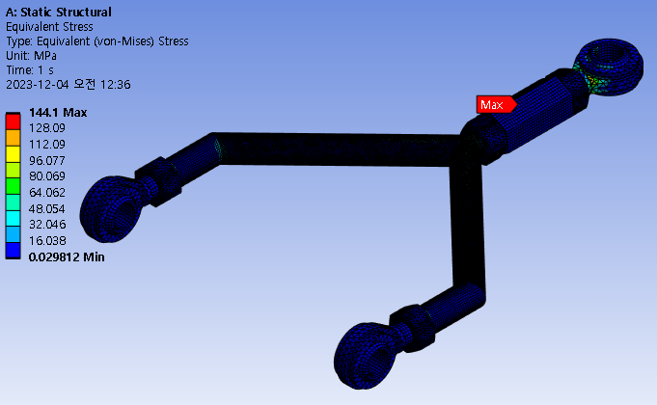
1-1. Front Upper – Linear Acceleration
PART 1.
PART 2.
PART 3.
4. Static Analysis
PART 5.
Average = 65.2 [Mpa] – Meshing [1mm]

Slide 19


1-2. Front Upper – Sudden Stop
PART 1.
PART 2.
PART 3.
4. Static Analysis
PART 5.
Average = 228.5 [Mpa] – Meshing [1mm]

Slide 20


1-3. Front Upper – Cornering
PART 1.
PART 2.
PART 3.
4. Static Analysis
PART 5.
Average = 845.1 [Mpa] – Meshing [1mm]

Slide 21


2-1. Front Lower – Linear Acceleration
PART 1.
PART 2.
PART 3.
4. Static Analysis
PART 5.
Average = 245 [Mpa] – Meshing [1.2mm]

Slide 22


2-2. Front Lower – Sudden Stop
PART 1.
PART 2.
PART 3.
4. Static Analysis
PART 5.
Average = 1440.5 [Mpa] – Meshing [1.2mm]

Slide 23


2-3. Front Lower – Cornering
PART 1.
PART 2.
PART 3.
4. Static Analysis
PART 5.
Average = 1030.4 [Mpa] – Meshing [1.2mm]

Slide 24


3-1. Rear Upper – Linear Acceleration
PART 1.
PART 2.
PART 3.
4. Static Analysis
PART 5.
Average = 390.55 [Mpa] – Meshing [1mm]

Slide 25


3-2. Rear Upper – Sudden Stop
PART 1.
PART 2.
PART 3.
4. Static Analysis
PART 5.
Average = 839.91 [Mpa] – Meshing [1mm]

Slide 26


3-3. Rear Upper – Cornering
PART 1.
PART 2.
PART 3.
4. Static Analysis
PART 5.
Average = 1316.07 [Mpa] – Meshing [1mm]

Slide 27


4-1. Rear Lower – Linear Acceleration
PART 1.
PART 2.
PART 3.
4. Static Analysis
PART 5.
Average = 190.38 [Mpa] – Meshing [1mm]

Slide 28


4-2. Rear Lower – Sudden Stop
PART 1.
PART 2.
PART 3.
4. Static Analysis
PART 5.
Average = 277.49 [Mpa] – Meshing [1mm]

Slide 29

4-3. Rear Lower – Cornering
PART 1.
PART 2.
PART 3.
4. Static Analysis
PART 5.
Average = 562.21 [Mpa] – Meshing [1mm]

Slide 30


5-1. Front Upper(New) – Linear Acceleration
PART 1.
PART 2.
PART 3.
4. Static Analysis
PART 5.
Average = 87.91 [Mpa] – Meshing [1mm]

Slide 31


5-2. Front Upper(New) – Sudden Stop
PART 1.
PART 2.
PART 3.
4. Static Analysis
PART 5.
Average = 167.01 [Mpa] – Meshing [1mm]

Slide 32


5-3. Front Upper(New) – Cornering
PART 1.
PART 2.
PART 3.
4. Static Analysis
PART 5.
Average = 188.68 [Mpa] – Meshing [1mm]

Slide 33


6-1. Front Lower(New) – Linear Acceleration
PART 1.
PART 2.
PART 3.
4. Static Analysis
PART 5.
Average = 184.00 [Mpa] – Meshing [1mm]

Slide 34


6-2. Front Lower(New) – Sudden Stop
PART 1.
PART 2.
PART 3.
4. Static Analysis
PART 5.
Average = 464.40 [Mpa] – Meshing [1mm]

Slide 35


6-3. Front Lower(New) – Cornering
PART 1.
PART 2.
PART 3.
4. Static Analysis
PART 5.
Average = 382.02 [Mpa] – Meshing [1mm]

Slide 36


7-1. Rear Lower(New) – Linear Acceleration
PART 1.
PART 2.
PART 3.
4. Static Analysis
PART 5.
Average = 144.58 [Mpa] – Meshing [1mm]

Slide 37


7-1. Rear Lower(New) – Sudden Stop
PART 1.
PART 2.
PART 3.
4. Static Analysis
PART 5.
Average = 100.36 [Mpa] – Meshing [1mm]

Slide 38


7-1. Rear Lower(New) – Cornering
PART 1.
PART 2.
PART 3.
4. Static Analysis
PART 5.
Average = 117.74 [Mpa] – Meshing [1mm]

Slide 39


8-1. Rear Upper(New) – Linear Acceleration
PART 1.
PART 2.
PART 3.
4. Static Analysis
PART 5.
Average = 306[Mpa] – Meshing [1mm]

Slide 40


8-2. Rear Upper(New) – Sudden Stop
PART 1.
PART 2.
PART 3.
4. Static Analysis
PART 5.
Average = 357.07 [Mpa] – Meshing [1mm]

Slide 41


8-3. Rear Upper(New) – Cornering
PART 1.
PART 2.
PART 3.
4. Static Analysis
PART 5.
Average = 770.17 [Mpa] – Meshing [1mm]

Slide 42
PART 5.
Result & Discussion

Slide 43







PART 1.
PART 2.
PART 3.
PART 4.
5. Result
$$σ_{y}=250 \left[Mpa\right]$$
$$σ_{ut}=460 [Mpa]$$
Linear Acceleration | $$σ_{avg}$$ | $S.F (σ_{y}$) | $$S.F (σ_{ut}\text{)}$$
Front Lower Arm | 245 | 1.02 | 1.88
Front Upper Arm | 65.2 | 3.83 | 7.06
Rear Lower Arm | 190.38 | 1.31 | 2.42
Rear Upper Arm | 390.5 | 0.64 | 1.18
Linear Acceleration | $$σ_{avg}$$ | $S.F (σ_{y}$) | $$S.F (σ_{ut}\text{)}$$
Front Lower Arm | 184 | 1.36 | 2.5
Front Upper Arm | 87.91 | 2.84 | 5.23
Rear Lower Arm | 144.58 | 1.73 | 3.18
Rear Upper Arm | 306 | 0.82 | 1.50
Sudden Stop | $$σ_{avg}$$ | $$S.F (σ_{y}\text{)}$$ | $$S.F (σ_{ut}\text{)}$$
Front Lower Arm | 1440.5 | 0.17 | 0.32
Front Upper Arm | 228.5 | 1.09 | 2.01
Rear Lower Arm | 277.49 | 0.90 | 1.66
Rear Upper Arm | 839.91 | 0.29 | 0.55
Sudden Stop | $$σ_{avg}$$ | $$S.F (σ_{y}\text{)}$$ | $$S.F (σ_{ut}\text{)}$$
Front Lower Arm | 464.40 | 0.54 | 0.99
Front Upper Arm | 167.01 | 1.49 | 2.75
Rear Lower Arm | 100.36 | 2.49 | 4.58
Rear Upper Arm | 357.07 | 0.70 | 1.29
Cornering | $$σ_{avg}$$ | $$S.F (σ_{y}\text{)}$$ | $$S.F (σ_{ut}\text{)}$$
Front Lower Arm | 1030.4 | 0.24 | 0.45
Front Upper Arm | 845.1 | 0.29 | 0.54
Rear Lower Arm | 562.21 | 0.44 | 0.82
Rear Upper Arm | 1316.07 | 0.19 | 0.35
Cornering | $$σ_{avg}$$ | $$S.F (σ_{y}\text{)}$$ | $$S.F (σ_{ut}\text{)}$$
Front Lower Arm | 382.02 | 0.65 | 1.20
Front Upper Arm | 188.68 | 1.32 | 2.43
Rear Lower Arm | 117.74 | 2.12 | 3.91
Rear Upper Arm | 770.17 | 0.32 | 0.60
< Old Version >
< New Version >

Slide 44
Conclusion
By changing the shape, the safety factor increased almost double.
If the diameter of pipe is increased 13.8mm to 17.3mm and the thickness is increased 1T to 2T, the safety factor will raise.

